Slide 1
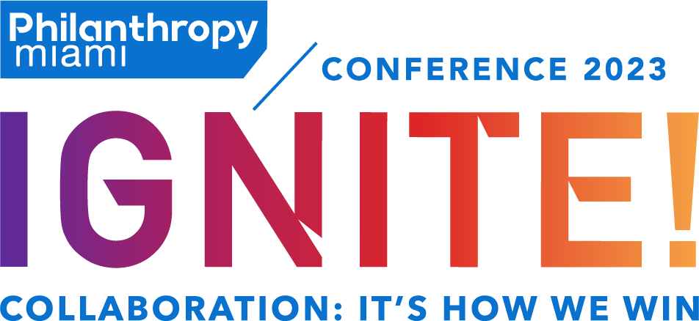
IGNITED FUNDRAISING
Solution Room: Annual Giving

Slide 2
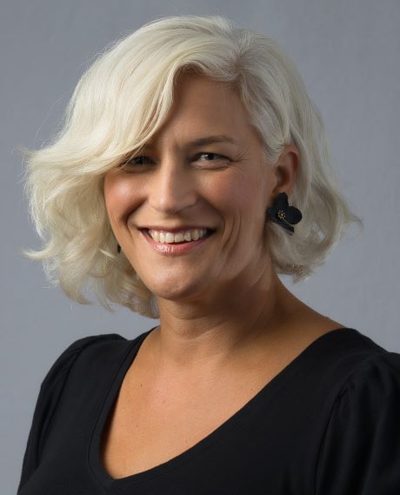
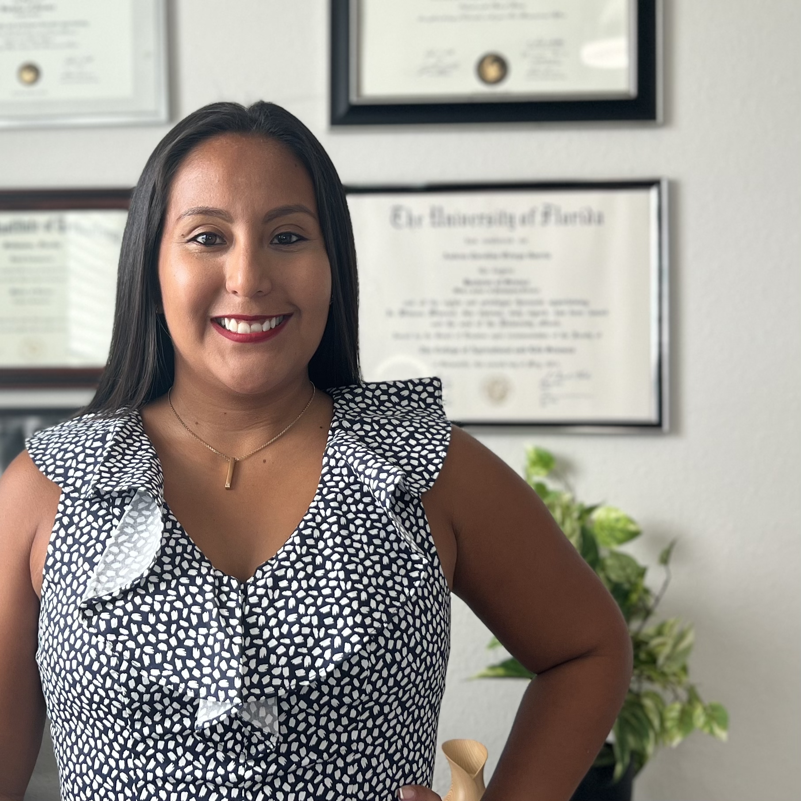
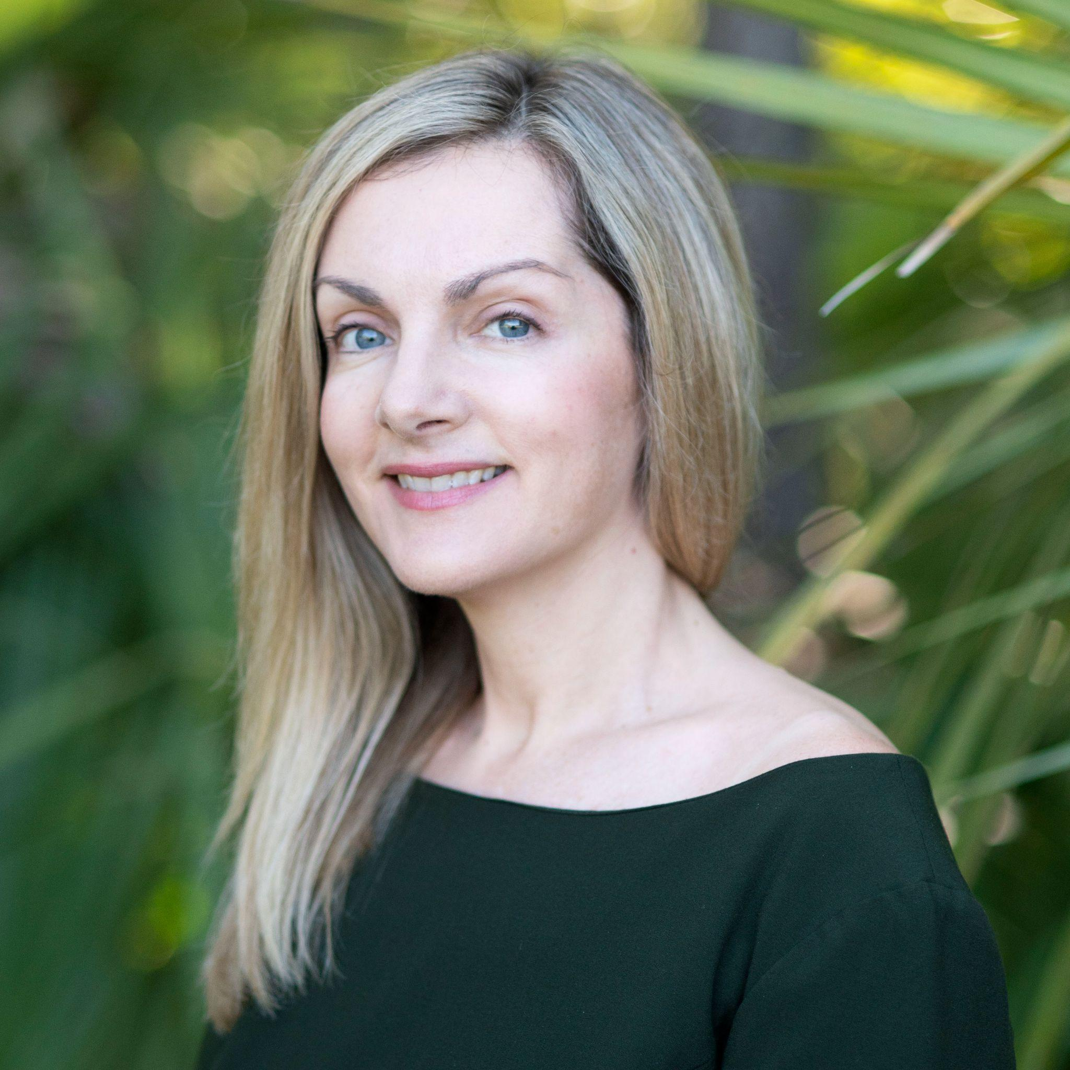
Meet the Panel
Nairobi Abrams
(she/her)
FIU Advancement
Andrea Ortega, NMN, CNP
(she/her)
Resilia
Krista Berry, MS
(she/her)
Candid
Eve Samples
(she/her)
Friends of the Everglades
Matt Williams
(he/him)
Miami City Ballet

Slide 3
What is annual giving?
Annual giving is defined as an organized effort to obtain gifts on a yearly basis to support, at least in part, the general operations of a nonprofit organization or an annual fund.
Source: Why annual giving should be your nonprofit’s priority

Slide 4
Solution Circles
Giving Days and Building the Pipeline
Nairobi Abrams
How to Create a Mid-level Donor Program
Eve Samples
Choose a topic and bring your problems, questions, challenges, success stories, lessons learned, and solutions to share
2 circles - 20 minutes each
Leveraging Technology
Andrea Ortega
Multi-Channel Communications Best practices for small nonprofits Matt Williams

Slide 5
Solution Circle
Incorporating Your Giving Day into an Annual Fundraising Strategy
This session will discuss integrating your current or new Giving Day into your organization's fundraising strategy, including donor acquisition, retention, and major gift prospect identification.
Giving Days and Building the Pipeline
Nairobi Abrams

Slide 6
Solution Circle
How to Create a Mid-level Donor Program
This session will go through step-by-step guide for small nonprofits seeking to create a sustainable pipeline for annual giving.
How to Create a Mid-level Donor Program
Eve Samples

Slide 7
Solution Circle
Leveraging technology can be essential in running an effective annual giving campaign.
This session will focus on leveraging technology in different aspects of your development and execution of your annual giving campaign. Maximizing your time to make data-driven decisions is key. Rather than throwing people at problems, utilizing technology, organizations can streamline their fundraising efforts, reach a wider audience, and gain valuable insights into donor behavior.
Leveraging Technology
Andrea Ortega

Slide 8
Solution Circle
A multi-channel approach to communication is important in engaging audiences and achieving desired outcomes.
This session will discuss how to use multi-channel communications to target specific audiences and the importance of high-quality data and segmentation. Be intentional and data-driven in your approach and be your organization’s advocate. Don’t feel obligated to copy your peers.
Multi-Channel Communications Best practices for small nonprofits Matt Williams

Slide 9
Reflections

Slide 10
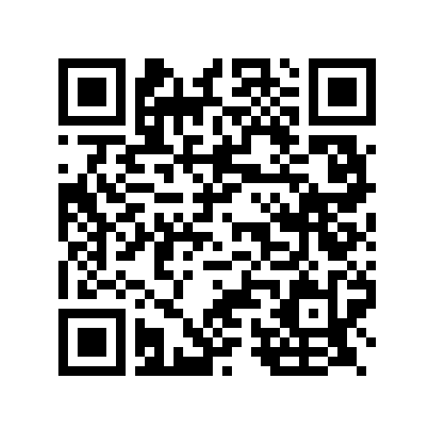
Resources
Matt Williams
Artist's Circle | Miami City Ballet
Eve Samples
Everglades Marjory’s Circle
Nairobi Abrams
Giving Tuesday Toolkit
Great Give Day Toolkit
Andrea Ortega
Learn More about Resilia Academy
4 Steps to a Successful Fundraising Strategy for BIPOC-led Organizations
Krista Berry
Candid Learning courses and resources
Blog: 5 fundraising ideas to start the year off strong

