Slide 1

Loving Your Donors
Orlando Gonzalez, SAVE
Orene Harris, Miami City Ballet
Jennifer Ray, Miami Jewish Health Foundation

Slide 2

The Scary Truth About Donor Retention

Slide 3
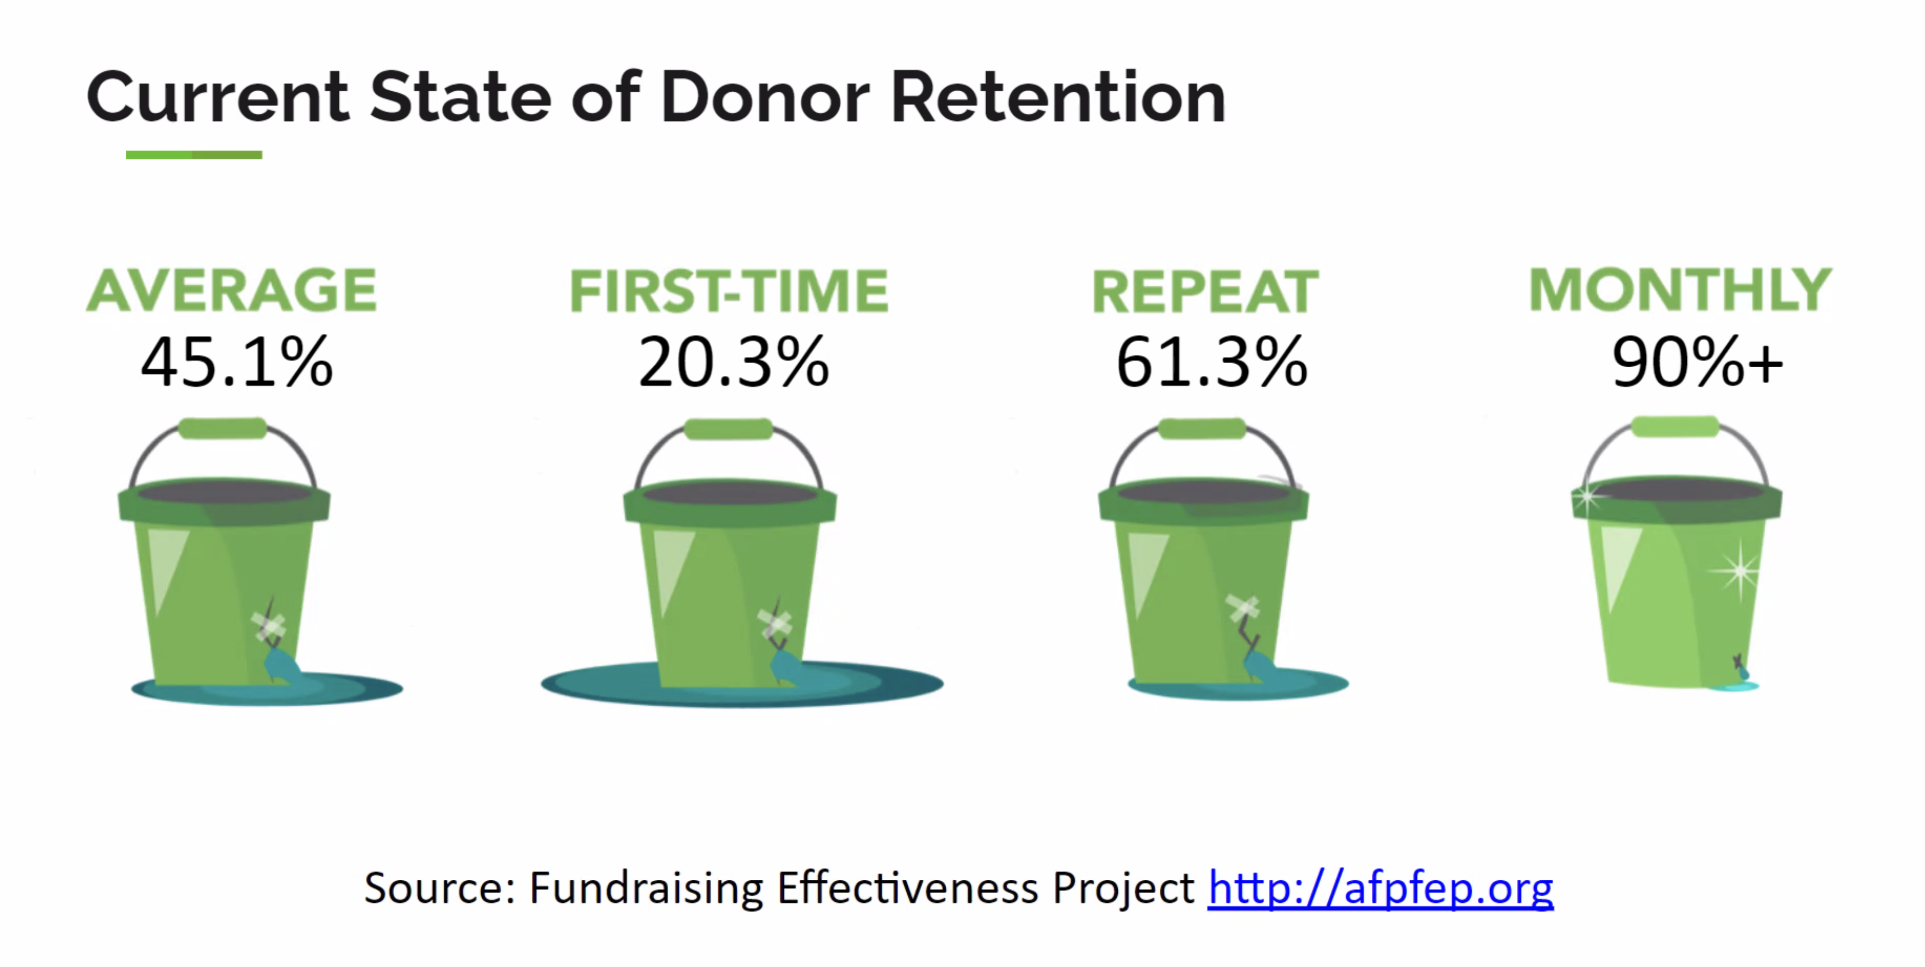

Slide 4

54% Could no longer afford to give.
16% Death.
18% Poor service or communication.
16% Others more deserving.
13% Never got thanked.
9% No memory of supporting.
8% No information on how gifts used.
5% Thought they were not needed.
Source: Adrian Sargeant via Bloomerang

Slide 5
What Science Says About Gratitude
Lowers blood pressure
Crates coherent thinking
Reduces stress
Helps you sleep better
Source: HeartMath Institute

Slide 6
I need only you.
Mohandas Gandhi

Slide 7

People have to give.
Subdues the power of money
Blesses the giver
Transforms lives

Slide 8

People will forget what you said. People will forget what you did. But people will never forget how you made them feel.
Maya Angelou

Slide 9
Stewardship
Outcome of gift-based activities that promote trust in the organization.
Julia Emlen
Journal of Stewardship & Donor Relations

Slide 10
Donor Relations
Outcome of donor-based activities that promote management of the relationship with the donor.
Julia Emlen
Journal of Stewardship & Donor Relations

Slide 11
Loving Your Donors
Orlando Gonzalez, SAVE
Orene Harris, Miami City Ballet
Jennifer Ray, Miami Jewish Health Foundation

Slide 12

On behalf of the Board of Trustees of the Springfield Food Pantry, I want to thank you for your generous gift of $1,000.
Your gift will make a big difference in the lives of the people we serve.

Slide 13

You have just done something wonderful.
Mary and John Smith turn to the Springfield Food Pantry each week to help keep their family of four fed. They lost their livelihood when their restaurant closed during the pandemic.
They are loving, responsible parents just struggling to get by.
Your gift of $1,000 made that a little easier. And for that, we cannot thank you enough.

Slide 14
Loving Your Donors
Orlando Gonzalez, SAVE
Orene Harris, Miami City Ballet
Jennifer Ray, Miami Jewish Health Foundation

